Slide 1


INDIAN INSTITUTE OF INFORMATION TECHNOLOGY
BHAGALPUR
AI - PROJECT
CS303 – Artificial Intelligence Lab
P8: 8 Puzzle Problem using IDA*
Submission date: 20/09/19
Submitted By:
Sunny Kumar (170101051)
Mithlesh Kumar Basfor (170101026)
Susheela (170102051)
Anil Kumar(170102005)
Anand Kumar(170101010)
Submitted To:
Dr. Rupam Bhattacharyya

Slide 2
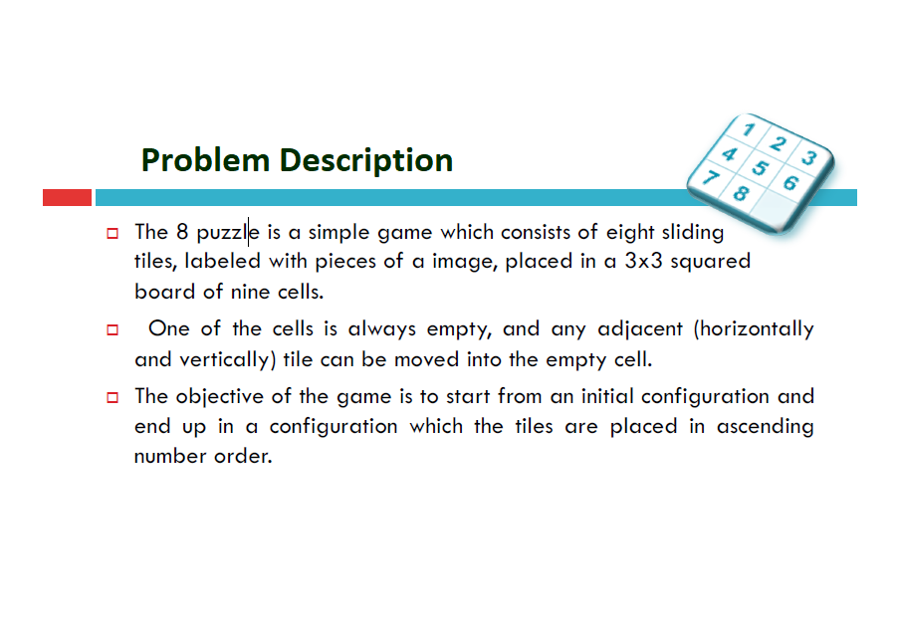

Slide 3
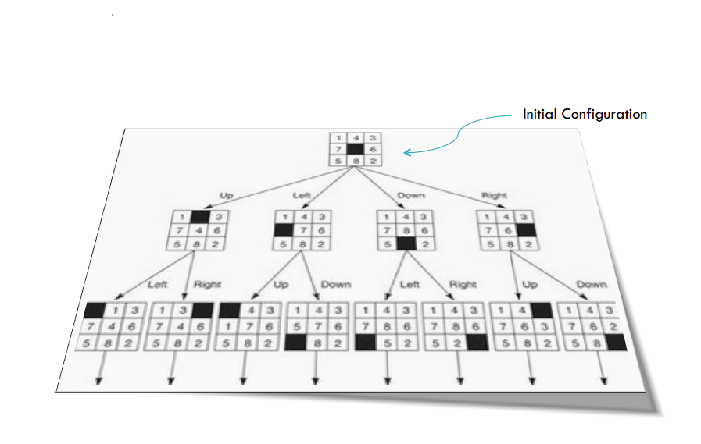

Slide 4
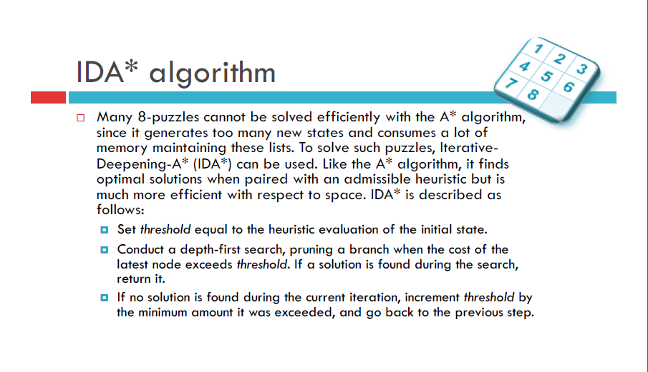

Slide 5
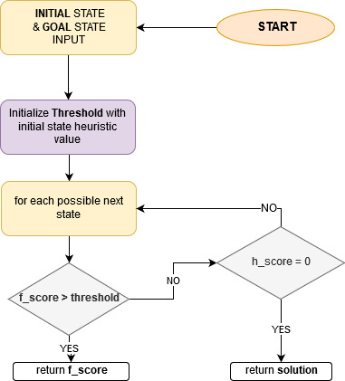
Flow Chart
END

Slide 6
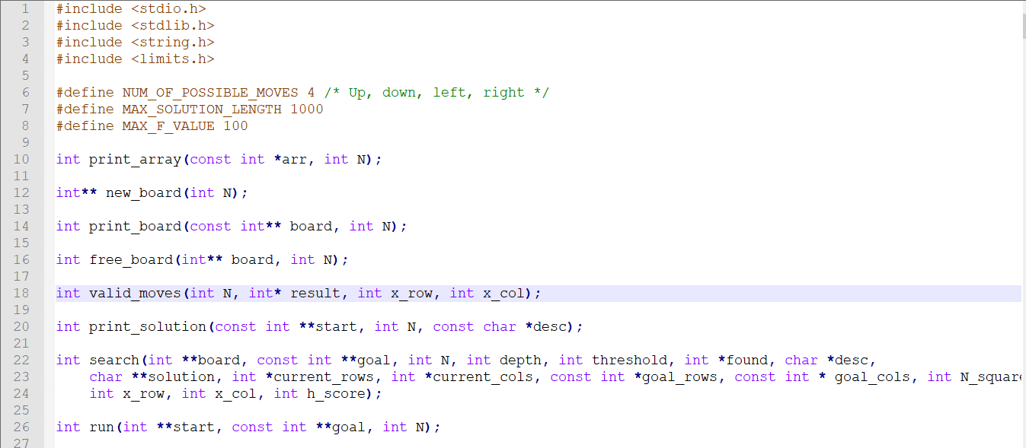
CODES :

Slide 7
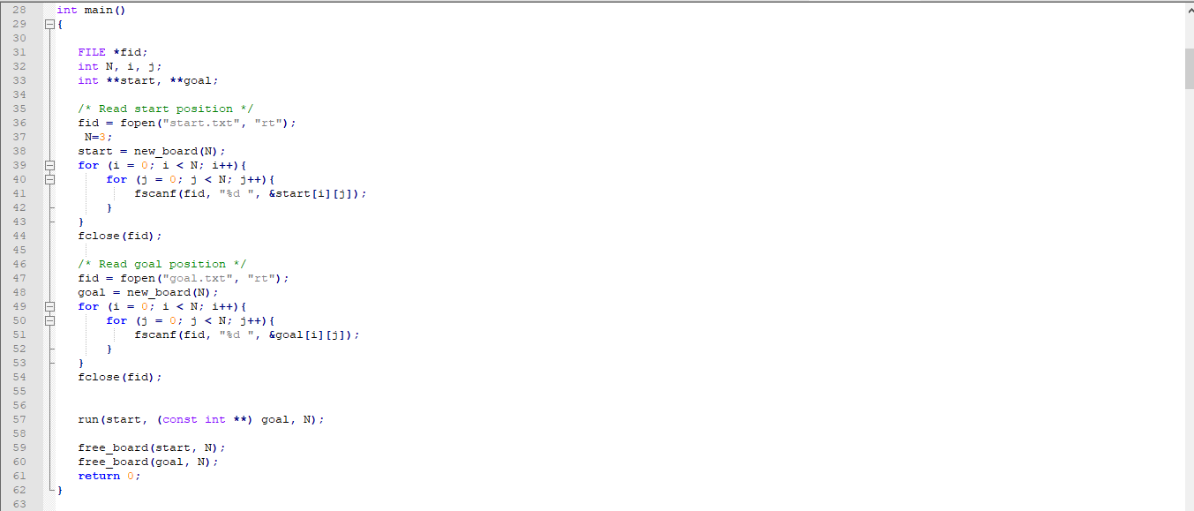

Slide 8
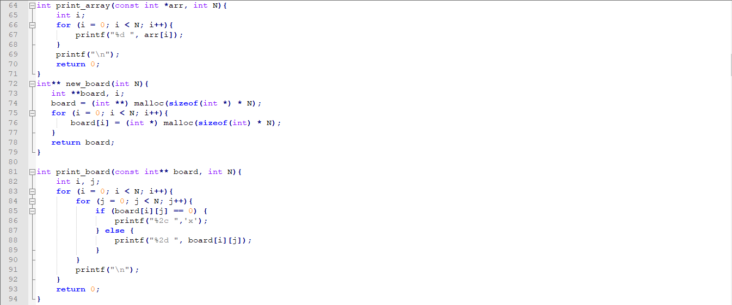

Slide 9
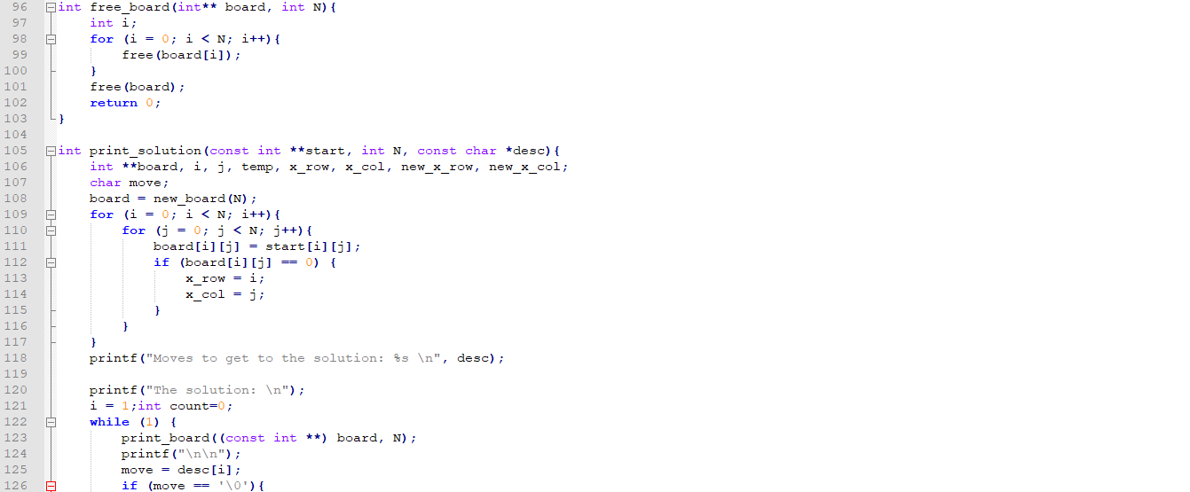

Slide 10
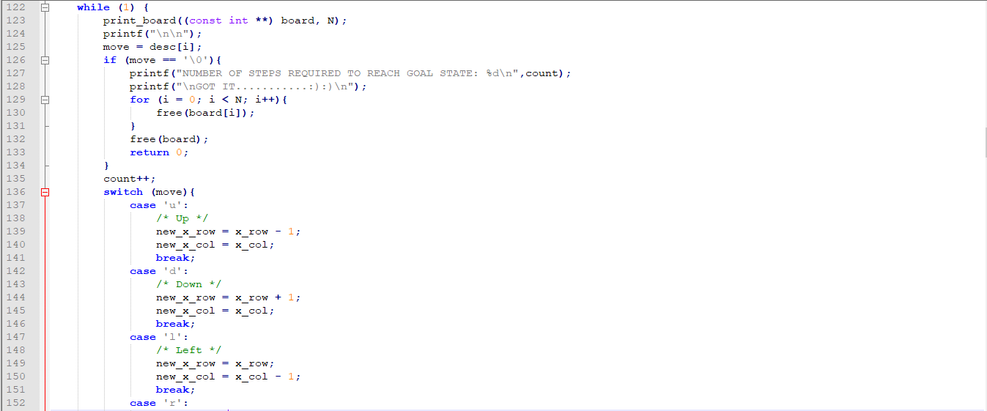

Slide 11
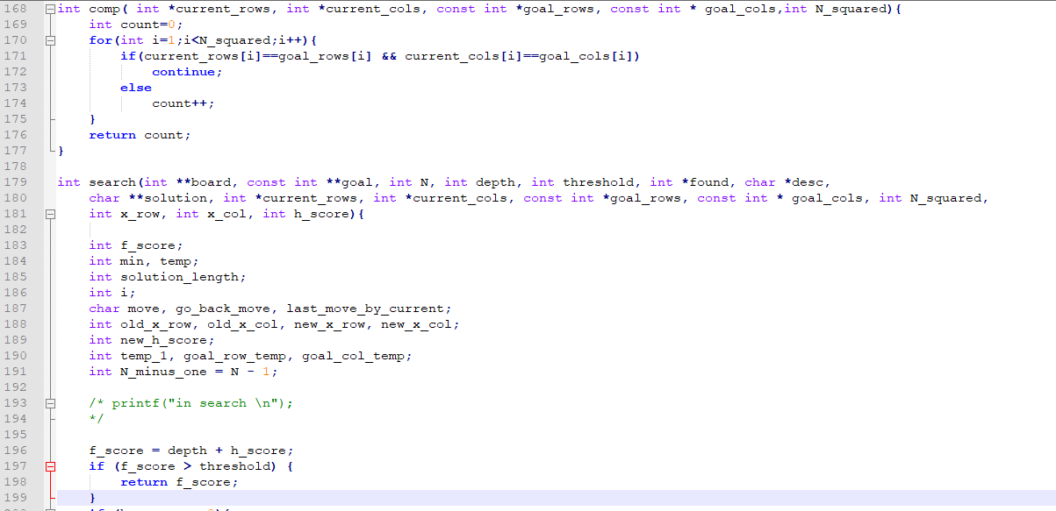

Slide 12
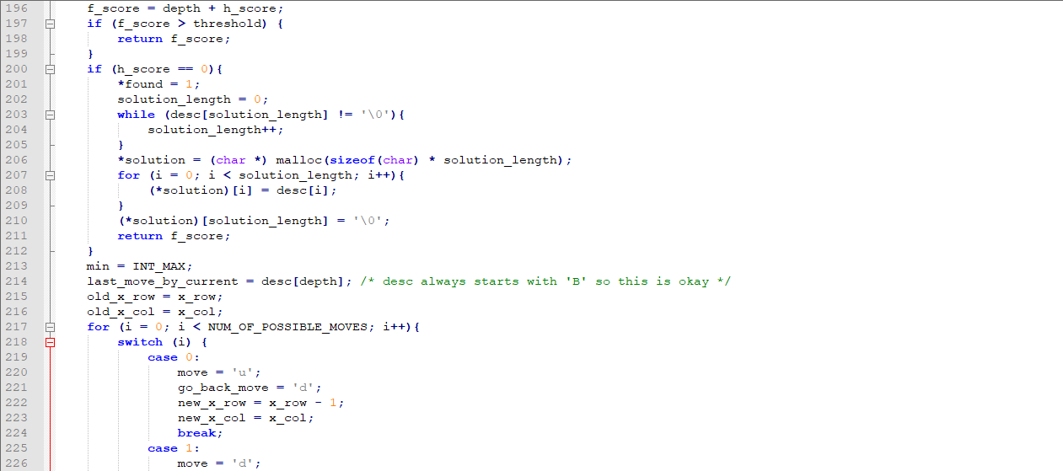

Slide 13
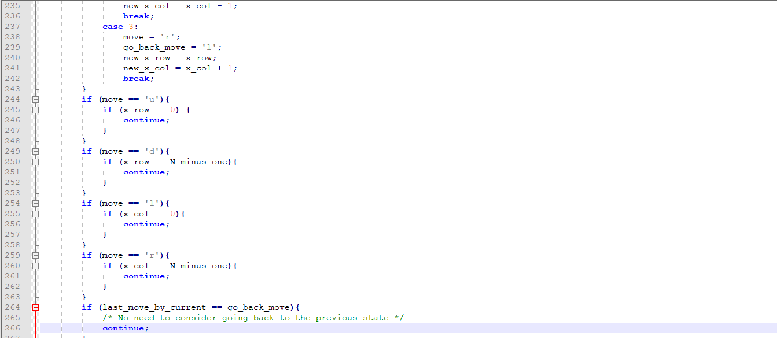

Slide 14
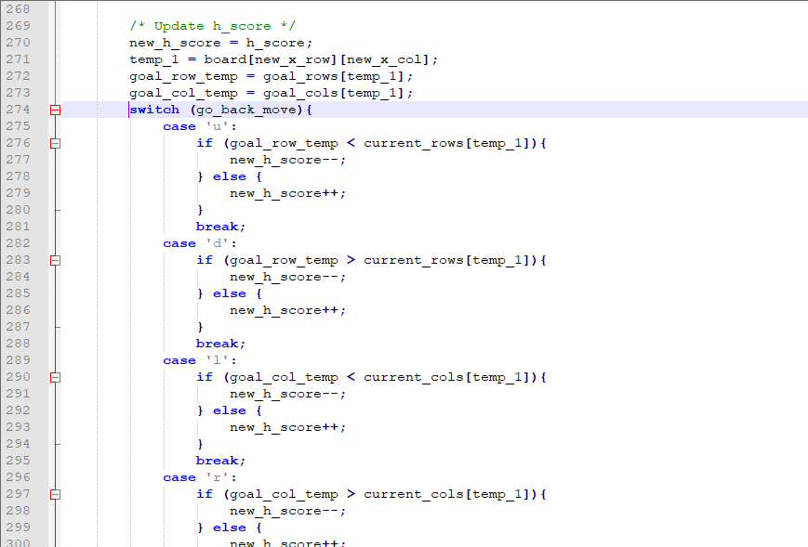

Slide 15
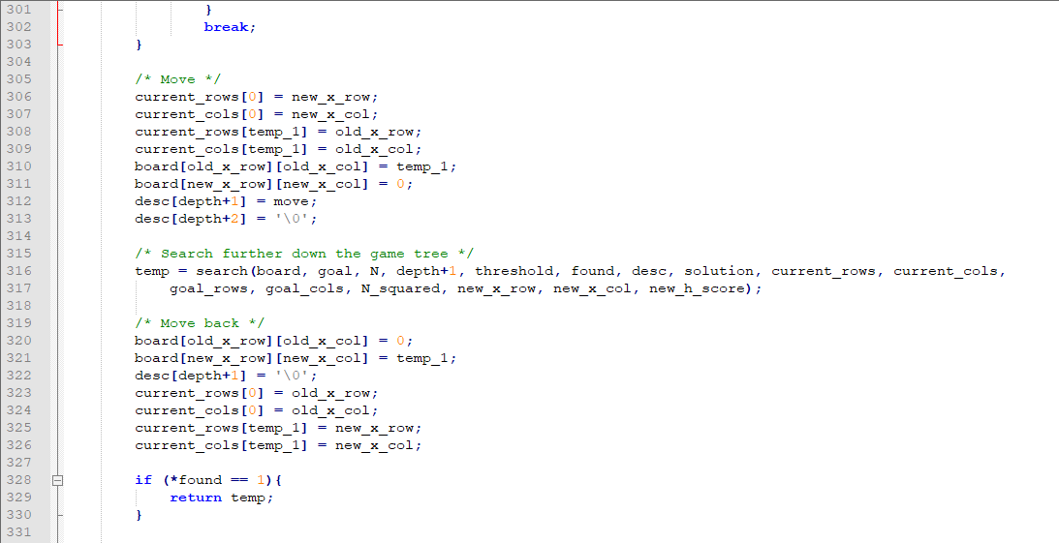

Slide 16
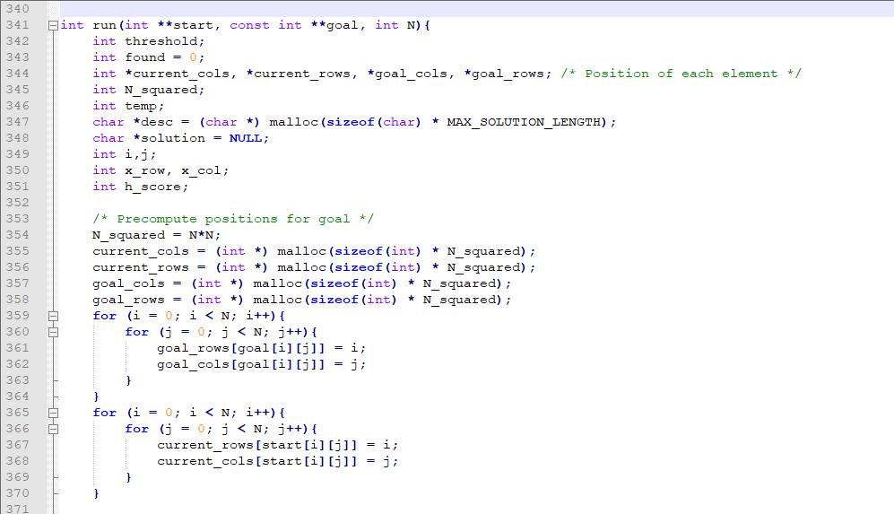

Slide 17
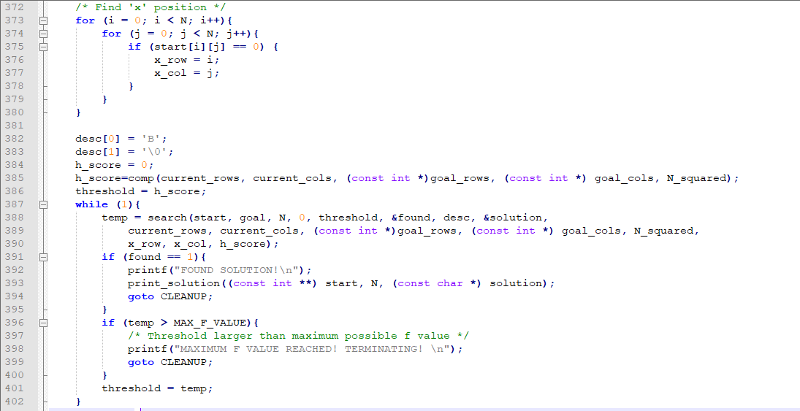

Slide 18
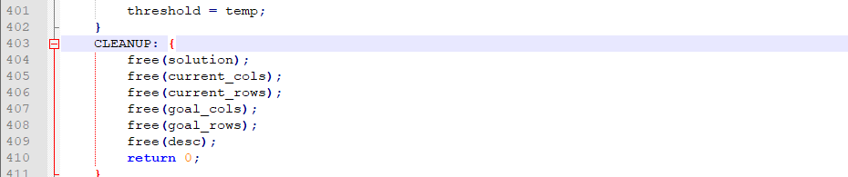
END of CODE with releasing space used
FULL CODE:
https://drive.google.com/open?id=1HmJ7Xm8Jem2jorvRoIgoymDE7-FxDANE

Slide 19
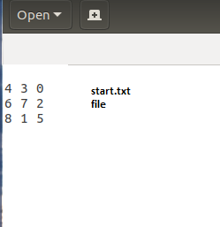
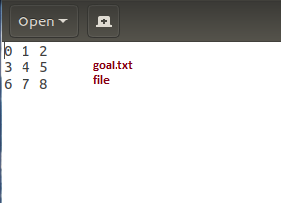
SOME SNAPSHOTS:

Slide 20
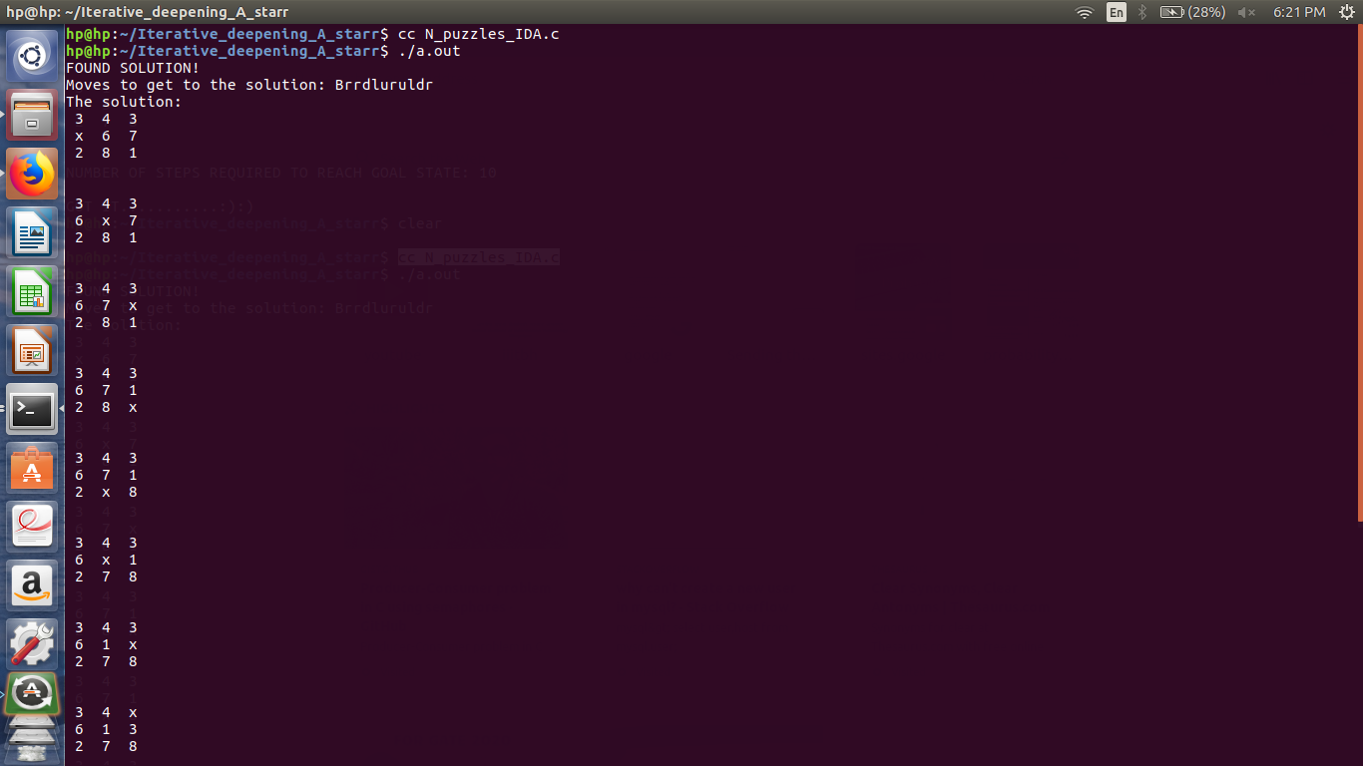

Slide 21
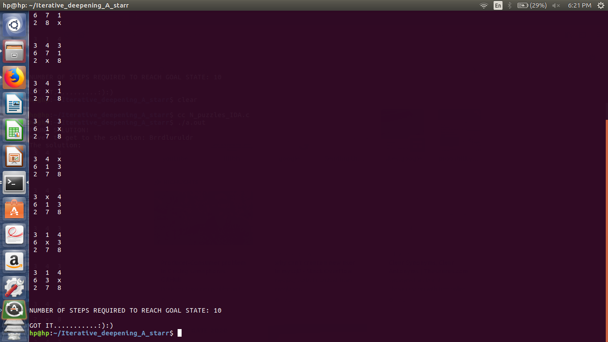

Slide 22
CONCLUSION CUM OBSERVATION
There are various searching algorithm for solving 8 puzzle but IDA* algorithm fetches the optimal solution among most of them.
The heuristic we used –” the number of misplaced tiles (excluding 0 tile) gives the optimal solution as compare to Manhattan heuristic function.
It also eliminates the memory constraints of A* algorithm without sacrificing optimality.

